Slide 1
MDO – Marketing Digital Outdoor
Design
Embedded Systems
Group 8:
José Pires | A50178
Hugo Freitas | A88258

Slide 2
Agenda
Recap
Problem statement
Analysis – System Overview
Theoretical Foundations
Design
HW
SW

Slide 3
1. Introduction

Slide 4
Problem Statement
The project consists of a marketing digital outdoor (MDO) with:
sound and video display, and fragrance emission selected by the brands,
providing a gesture-based interface for user interaction to create pictures and GIFs, brand-specific,
and share them on social media.

Slide 5
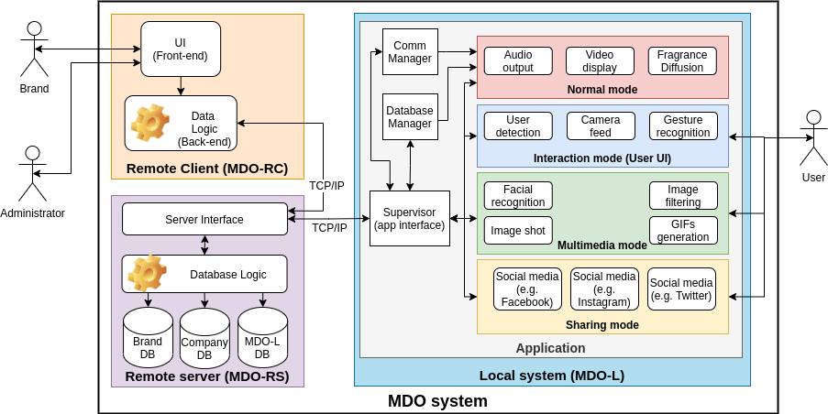
Analysis System Overview

Slide 6
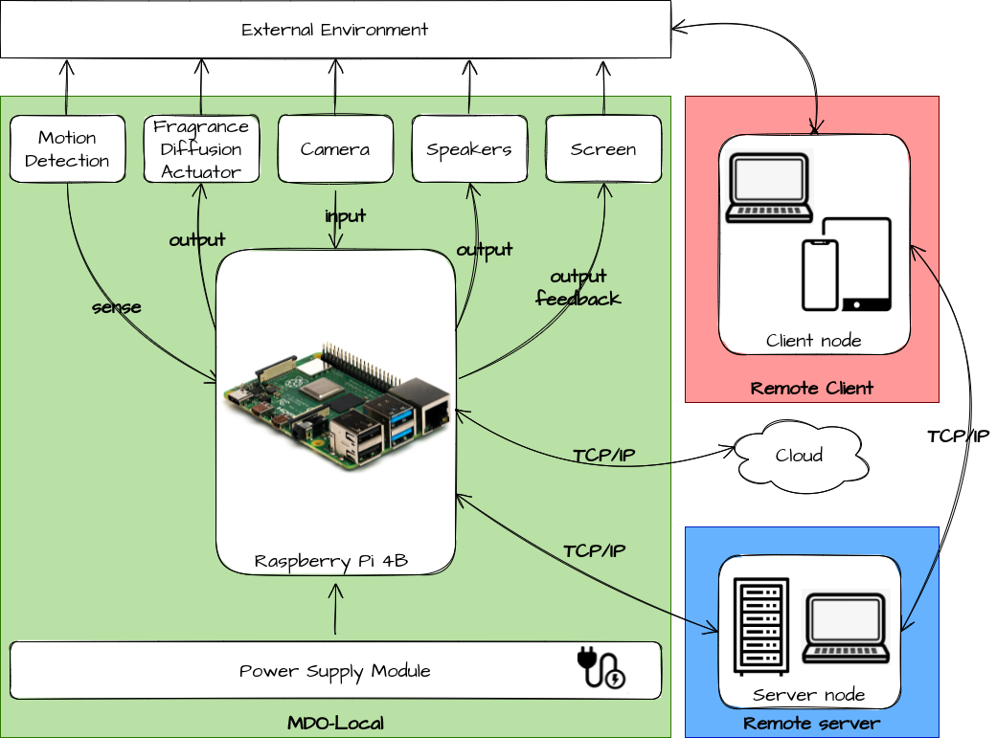
Analysis System Overview
Hardware Architecture

Slide 7
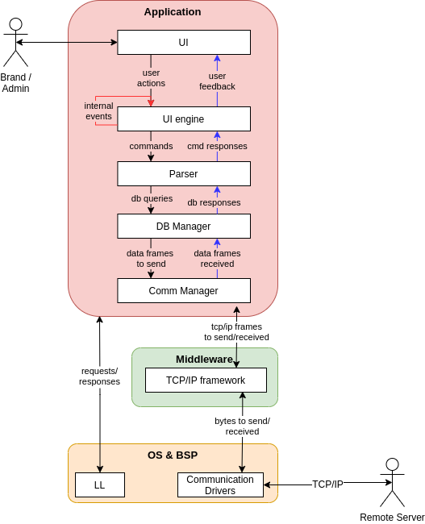
Analysis System Overview
Software Architecture
Remote Client

Slide 8
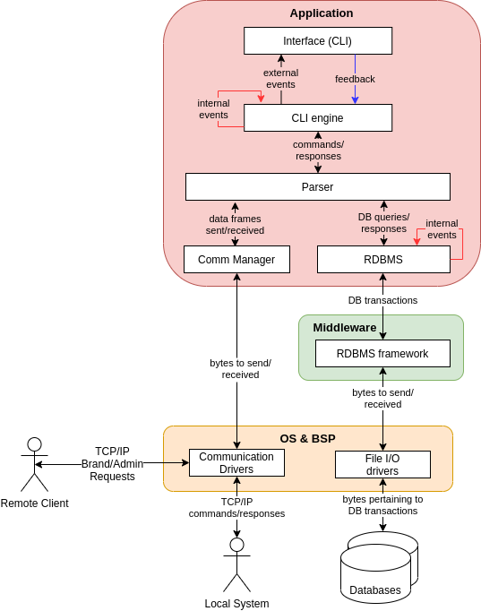
Analysis System Overview
Software Architecture
Remote Server

Slide 9
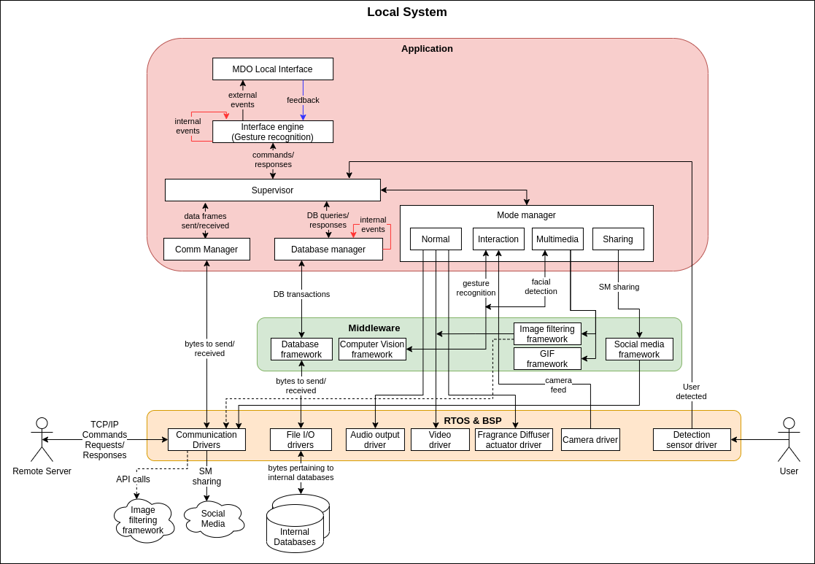
Analysis System Overview
Software Architecture – Local System

Slide 10
2. Theoretical Foundations

Slide 11
Theoretical Foundations Scenting Technologies
These are all the topics that are addressed in this project:
Project Methodology;
Concurrency;
Threads versus processes;
Communications;
Daemons;
Device Drivers;
Build systems and Makefiles;
Source code documentation;

Slide 12
Theoretical Foundations Scenting Technologies
These are all the topics that are addressed in this project:
Scenting Technologies;
Computer Vision;
RDBMS;
Motion Detection;
Camera Recording and codecs;
Image filtering;
GIF Generation;
Social Media APIs
UI Framework
File transfer Protocols

Slide 13
Theoretical Foundations Scenting Technologies
A scenting technology transforms an aromatic liquid into a gaseous fluid that can be conveyed through the air and be captured by human olfactory sense, usually for therapeutic or marketing purposes.
Types:
Thermalization
Heat source to induce evaporation
Causes adulteration of the fragrance
Energy intensive process
Evaporation
Natural evaporation of the chemicals
Too slow
Atomization
Ultrasonic:
use water
Simpler
cheaper
Nebulizers:
don’t use water
Don’t cause adulteration of the fragrance
More expensive and more costly

Slide 14
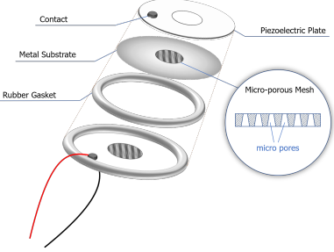
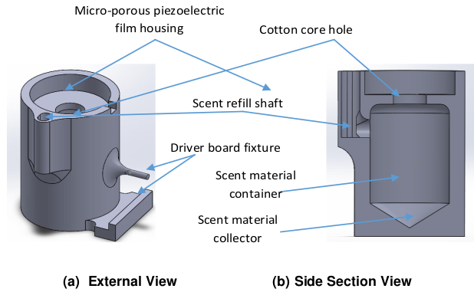
Theoretical Foundations Scenting Technologies
Ultrasonic Diffusion:
high frequency stimuli (>20 kHz) to brake down water molecules into droplets, producing mist, diffusing the oils into the air.
Accomplished using micro-mesh piezoelectric transducers.

Slide 15
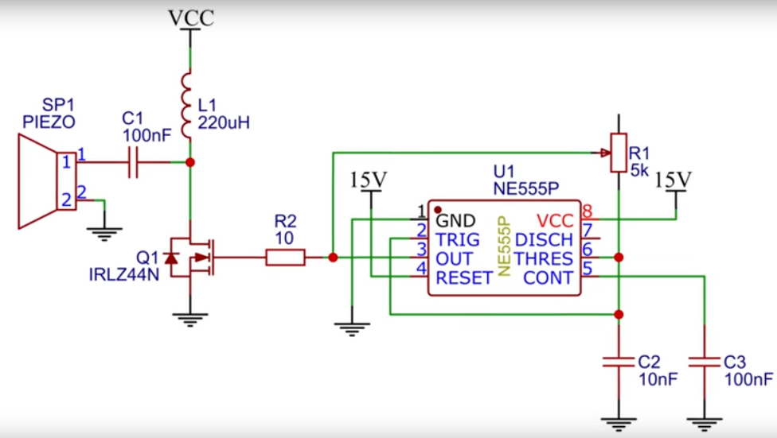
Theoretical Foundations Scenting Technologies
Ultrasonic Diffusion:
high frequency stimuli (>20 kHz) to brake down water molecules into droplets, producing mist, diffusing the oils into the air.
Accomplished using micro-mesh piezoelectric transducers.

Slide 16
Theoretical Foundations Computer Vision
Transformation of data from a still image or video camera into either a decision or a new representation to achieve some particular goal [36].
Computer vision framework
OpenCV: it is an open-source computer vision and machine learning software library, built to provide a common infrastructure for computer vision applications and accelerate the use of machine perception in commercial products.
Face detection
Recent studies [47, 48] show that face detection can be further improved by using deep learning, leveraging the high capacity of deep convolutional networks.

Slide 17
Theoretical Foundations Computer Vision
Haar Cascade classifier

Slide 18
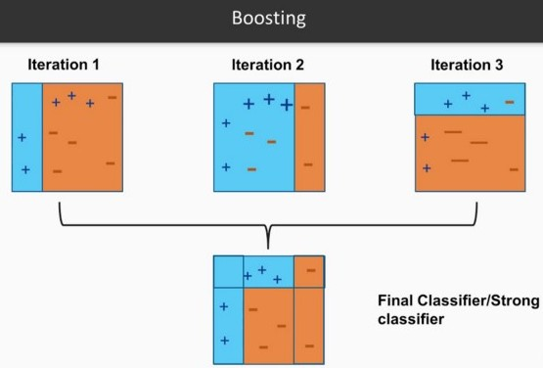
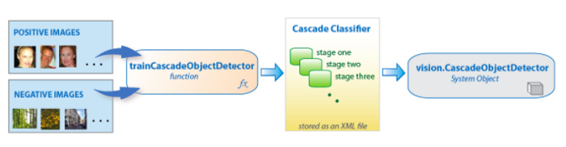
Theoretical Foundations Computer Vision
Haar Cascade classifier

Slide 19
Theoretical Foundations Computer Vision
Hand Gesture Recognition

Slide 20
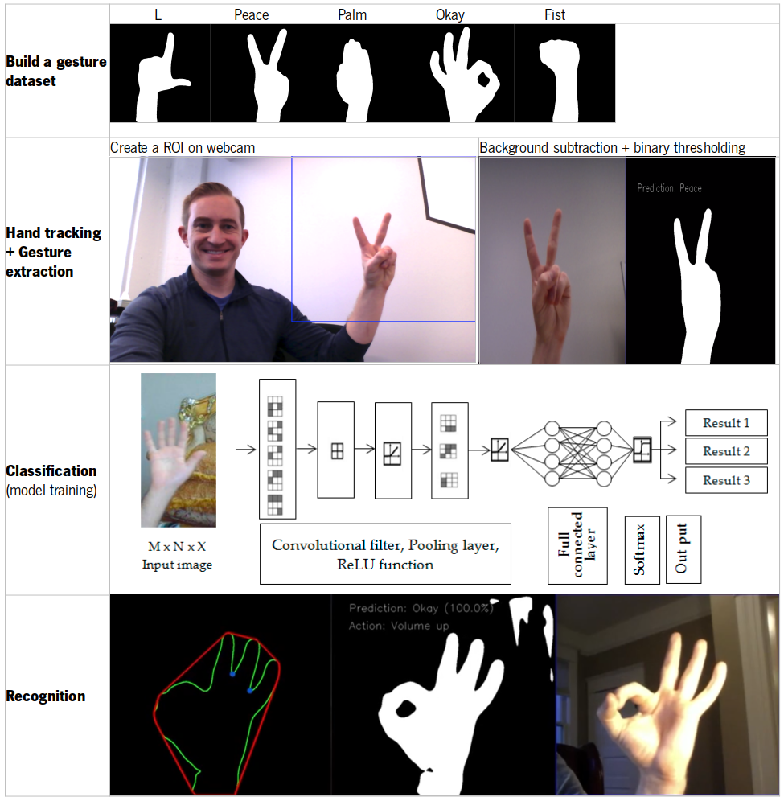
Theoretical Foundations Computer Vision
Hand Gesture Recognition

Slide 21
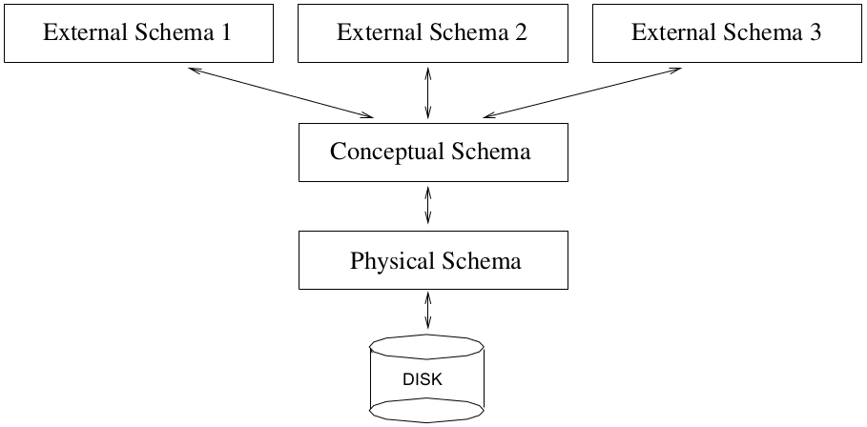
Theoretical Foundations RDBMS
Levels of abstraction

Slide 22
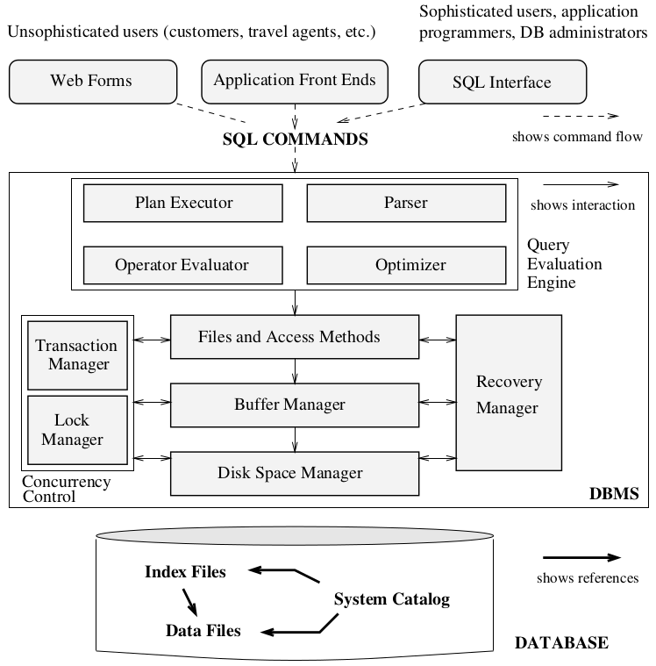
Theoretical Foundations RDBMS
Structure

Slide 23
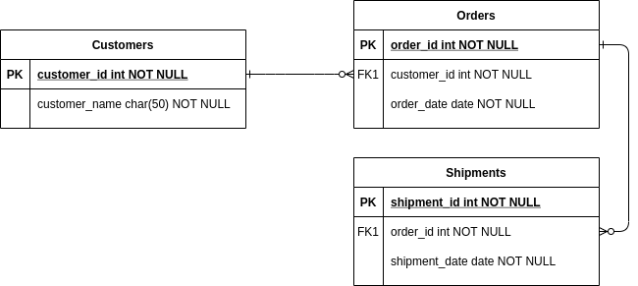
Theoretical Foundations RDBMS
Database Design: Entity-Relation Diagram (ERD)

Slide 24
Theoretical Foundations RDBMS
RDBMS selection:
Oracle Database: proprietary
Microsoft SQL Server: proprietary
MySQL:
Open-source
Scalable
Client-server architecture
User authentication & Security features
SQLite
Open-source
File-based (not scalable)
Lacks user authentication & Security features

Slide 25
Theoretical Foundations RDBMS
Structured Query Language (SQL):
Data Definition Language (DDL)
Data Manipulation Language (DML)

Slide 26
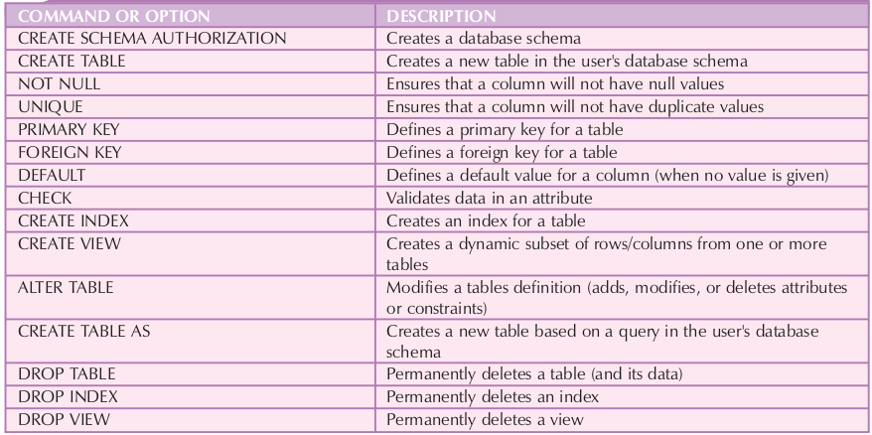
Theoretical Foundations RDBMS
SQL: Data Definition Language (DDL)

Slide 27
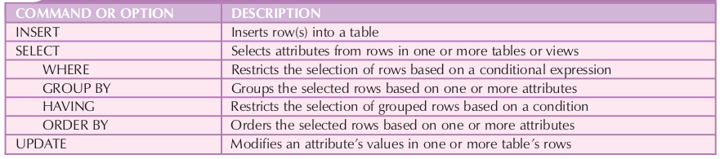
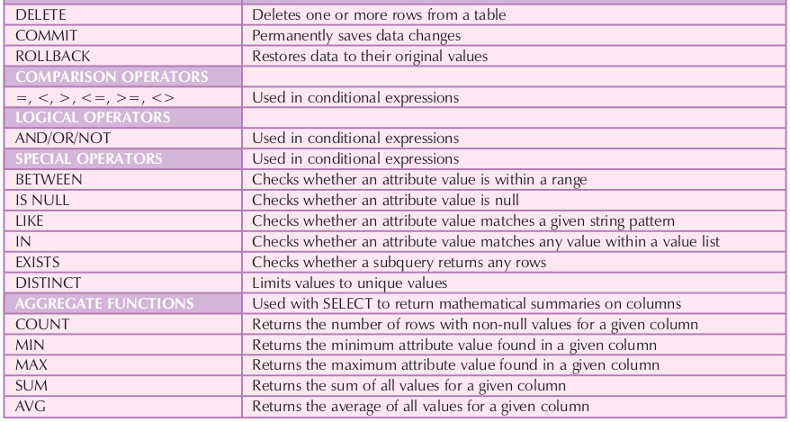
Theoretical Foundations RDBMS
SQL: Data Manipulation Language (DML)

Slide 28
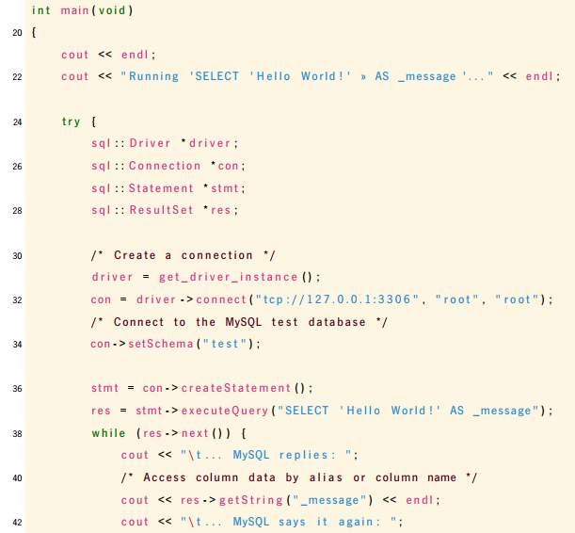
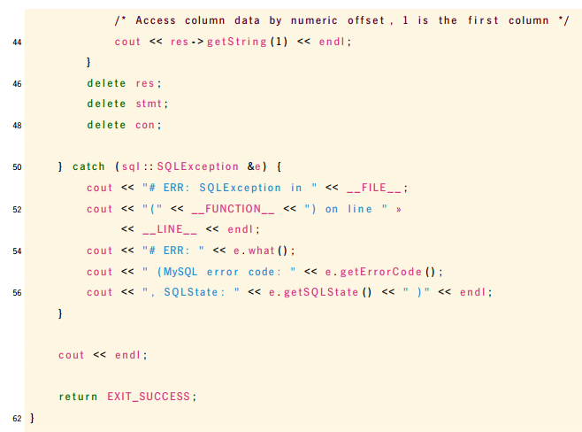
Theoretical Foundations RDBMS
MySQL C++ connector:

Slide 29
Theoretical Foundations Motion Detection
The MDO-L needs to be capable of detecting a user, in order to switch between normal mode to interaction mode.
Ultrasonic Sensor
The sensor determines the distance to a target by measuring time lapses between the sending and receiving of the ultrasonic pulse [69].

Slide 30
Theoretical Foundations Camera recording and codecs
Video encoding formats, also called video file formats, are methods of optimizing digital video files for different platforms, programs, and devices.
Processes of video encoding:
Compression: decreases the size of a video file so that it is more manageable. Without proper compression, most files would be far too large to upload easily, load quickly, or play smoothly on users’ devices.
Transcoding: refers to the total audio and video conversion process from one video format to another. It ensures that a video file is compatible with the video player and/or platform it is using. Without transcoding, users would not be able to watch the video file at all.

Slide 31
Theoretical Foundations Image Filtering
After detect the face, it is now possible to apply filters like this figure.
Scaling the image having in touch the face size and put the image in front of the face.

Slide 32
Theoretical Foundations GIF Generation
The main features of GIF are:
Up to 256 colors using 1 to 8 bits per pixel
Multiple images per file: supporting animation.
APIs
MagickWand — C [78]: recommended interface between the C programming language and the ImageMagick image processing libraries.
MagickCore — C [79]: low-level interface between the C programming language and the ImageMagick image processing libraries. Recommended for power users.
Magick++ — C++ [80]: object-oriented C++ API to the ImageMagick image-processing library.
It supports manipulation and conversion of OpenCV data structures — which are used to store frames from the camera and to process them — thus making it the chosen solution.

Slide 33
Theoretical Foundations Social Media Sharing APIs
These platforms expose a set of features through APIs to external agents interact with them in a programmatic way, enabling automation of tasks like content sharing, scheduling, search, etc.
Twitter: less complex API from all SMs

Slide 34
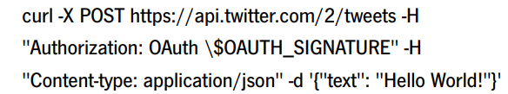
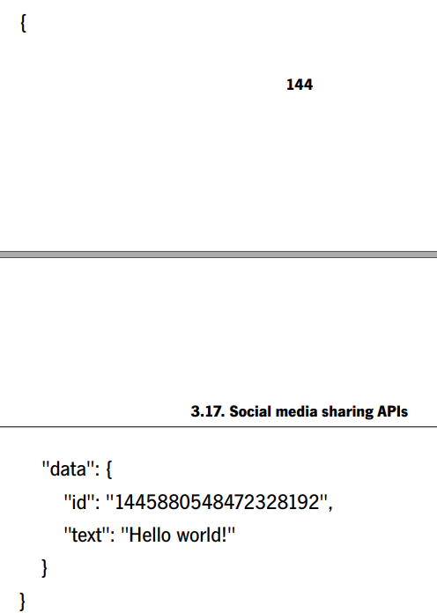
Theoretical Foundations Social Media Sharing APIs
Twitter API: To interact with the Twitter platform, one can make a request and retrieve its response by following these steps [87]:
Select the end-point;
Select a tool to make the request;
Review the response;
Adjust the request using parameters.

Slide 35
Theoretical Foundations UI Framework
QT was the chosen one for the following reasons:
Allows cross development;
Cost: open-source license (free) and faster to implement
Implementation: implemented in C++, which means that it is possible to use many libraries.

Slide 36
Theoretical Foundations File Transfer Protocols
HTTPS:
The communications between subsystems are made through TCP/IP, this is also used in this protocol which is an advantage;
The data is transferred only with authentications (request and responses) which makes it more secure;
All communication is encrypted, which makes it even more secure.
Third Party API:
Transfer.sh: This application has easy-to-use commands in order to transfer files with a URL, there is unlimited upload, it can encrypt files and it is also possible to limit the amount of downloads and days available of downloading [104].
Curlpp: Using the library curlpp with the transfer.sh API, it is possible to create a program to transfer files between nodes automatically when requested from the user

Slide 37
3. Design

Slide 38
3.1. Hardware

Slide 39
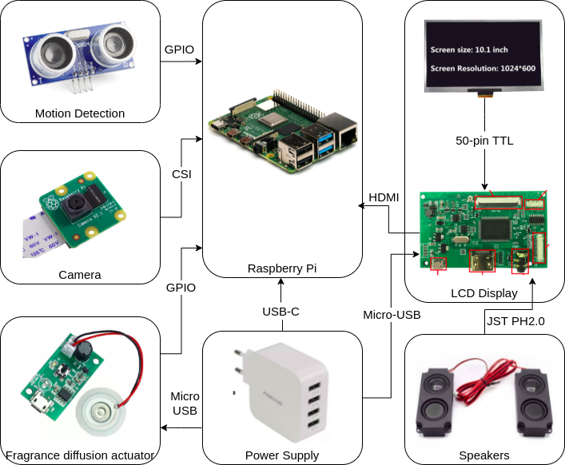
Design Hardware Architecture

Slide 40
Design Hardware Architecture
Main Controller:
Processor: Broadcom BCM2711 processor, quad-core Cortex-A72 (ARM v8) 64-bit with 1.5GHz;
Memory: 4GB LPDDR4 with on-die ECC;
Connectivity: 2.4 GHz and 5.0 GHz IEEE 802.11b/g/n/ac wireless LAN, Bluetooth 5.0 with low energy, one Gigabit Ethernet port, four USB ports in which two are 3.0 and another two are 2.0;
GPIO: standard 40-pin GPIO fully backwards-compatible with previous boards;
Video and Sound: two HDMI ports that support up to 4kp60, a 2-lane MIPI DSI display port, a 2-lane MIPI CSI camera port and a 4-pole stereo audio and composite video port;
Multimedia: H.265 (4Kp60 decode), H.264(1080p60 decode and 1080p30 encode) and OpenGL ES 3.0 graphics;
SD card support: Micro SD card slot for loading operating system and data storage;
Input power: 5V Direct Current (DC) via USB-C connector (minimum 3A), 5V DC via GPIO header (minimum 3A) and Power over Ethernet (PoE) - enabled (requires separate PoE HAT);
Environment: it has a range of operation between 0ºC and 50ºC.

Slide 41
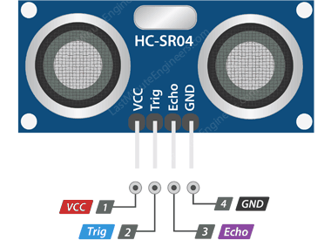
Design Hardware Architecture
Motion Detection(HC-SR04):
Operating Voltage: 5V DC;
Operating Current: 15 milliampere (mA);
Operating Frequency: 40 KHz;
Maximum Range: 4 meters;
Minimum Range: 2 centimeters;
Ranging Accuracy: 3 millimeters;
Measuring Angle: 15 degrees;
Trigger Input Signal: 10 microseconds TTL pulse;
Dimension: 45 x 20 x 15 millimeters.

Slide 42
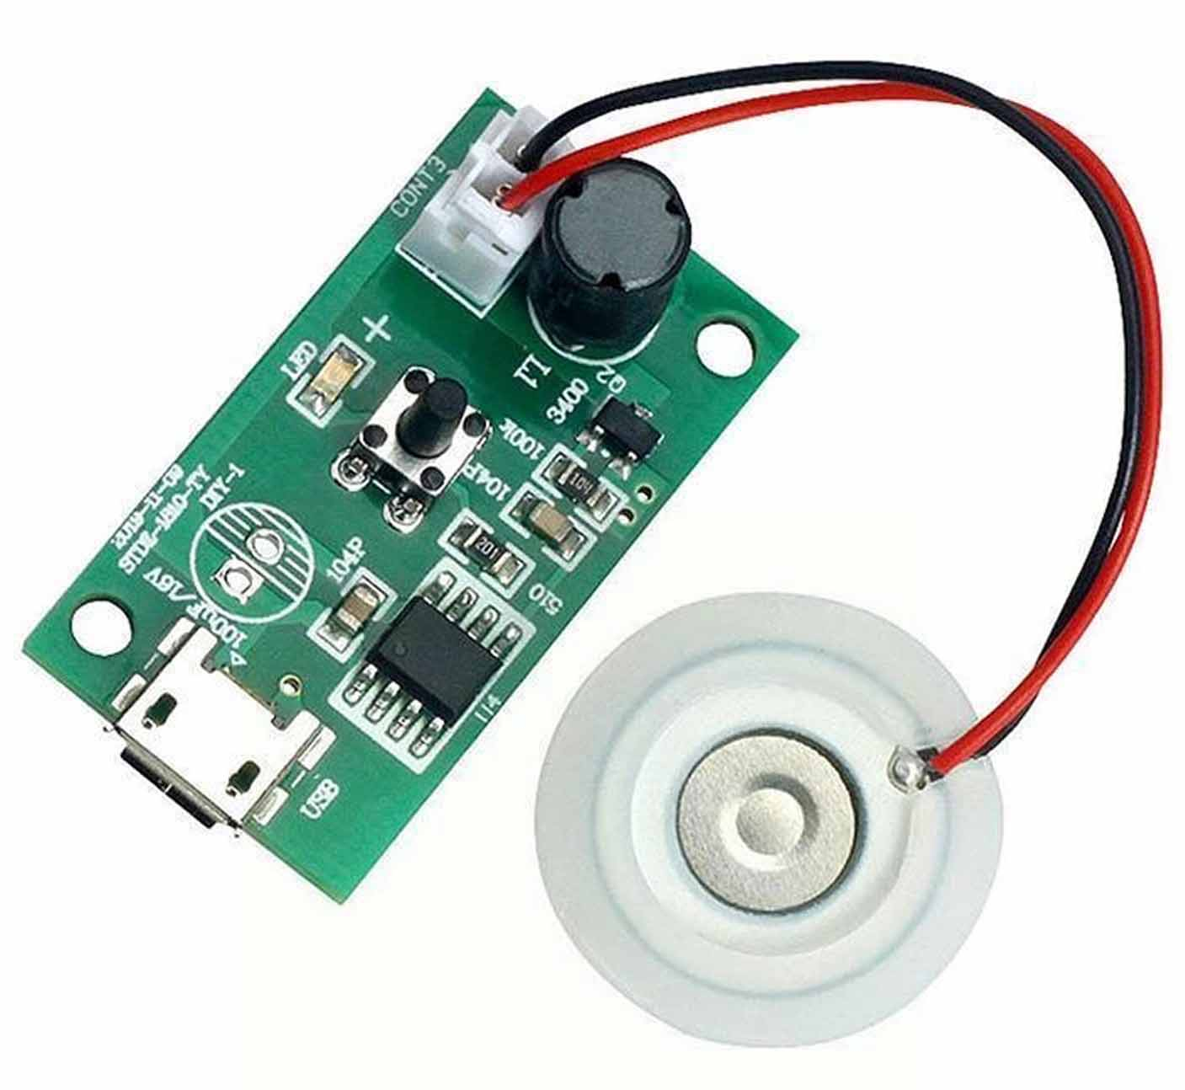
Design Hardware Architecture
Fragrance diffusion actuator:
Operating Voltage: 5V DC;
Operating Current: 300 milliampere (mA);
Operating Power: 2 W;
Operating Frequency: 108 kHz;
Dimension: 35 x 20 x 17 millimeters.

Slide 43
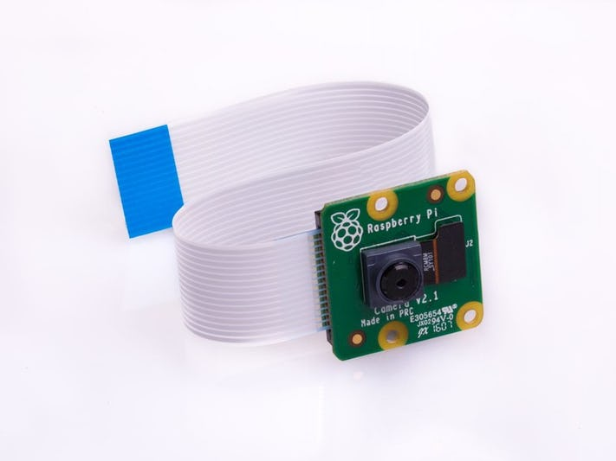
Design Hardware Architecture
Camera (Raspberry Pi Camera Module V2):
Sensor: Sony IMX219 8-megapixel;
Quality: 1080p30, 720p60;
Interface: CSI;

Slide 44
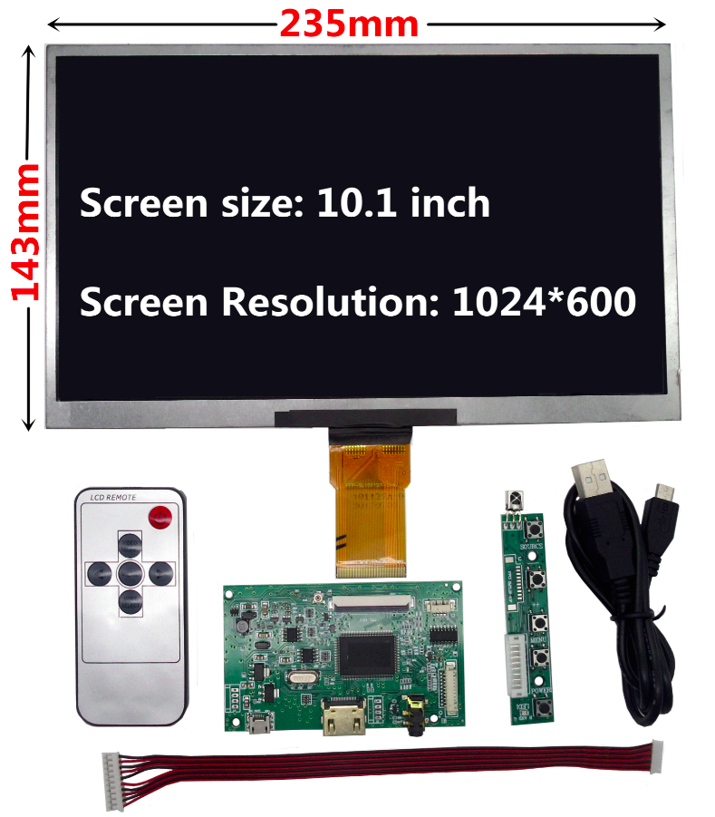
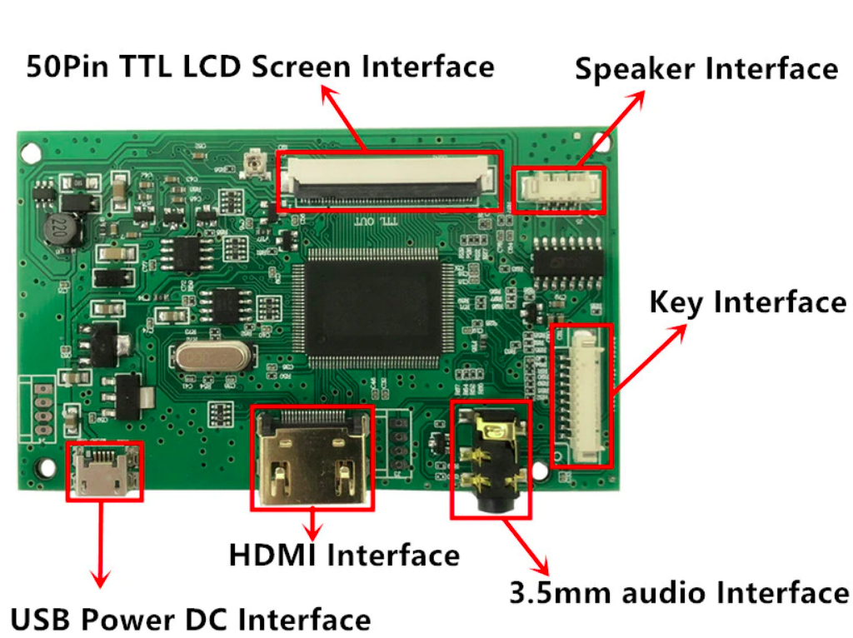
Design Hardware Architecture
LCD Display:

Slide 45
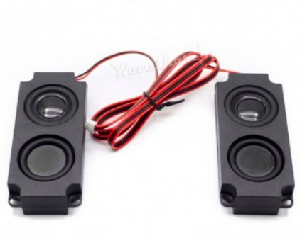
Design Hardware Architecture
Speakers (Raspberry Pi Camera Module V2):
Impedance: 8 Ohm;
Power: 5 W;
Interface: JST PH2.0.

Slide 46
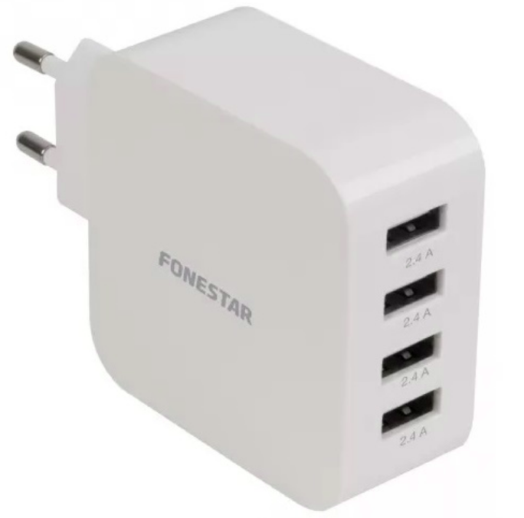
Design Hardware Architecture
Power Supply:
Output: 4 USB-A 2.4 A ports.

Slide 47
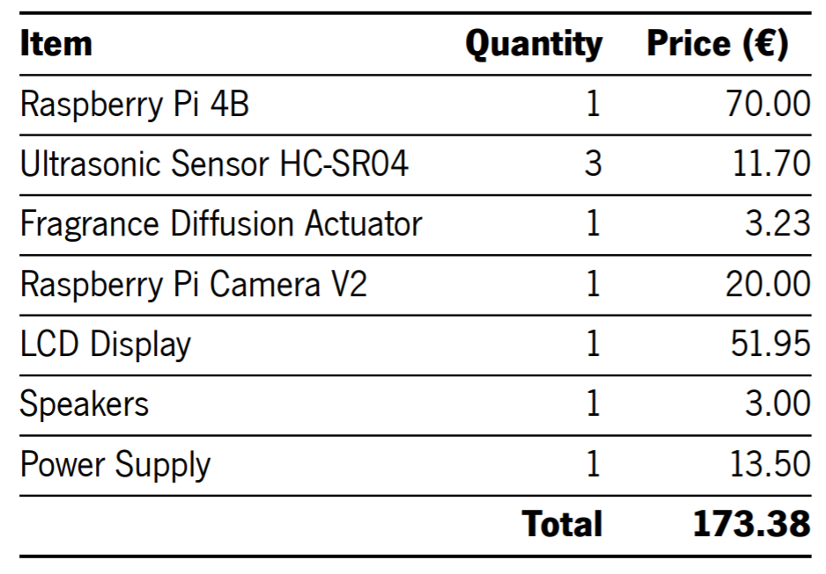
Design Hardware Architecture
Total cost:

Slide 48
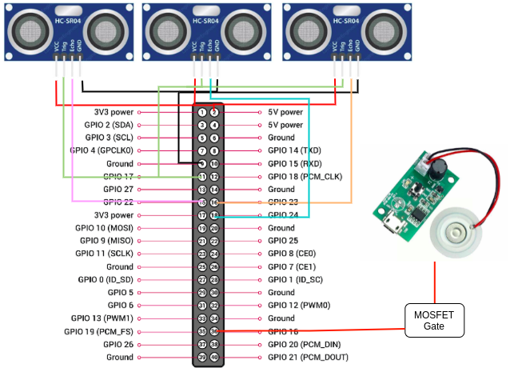
Design Hardware Interfaces Definition

Slide 49
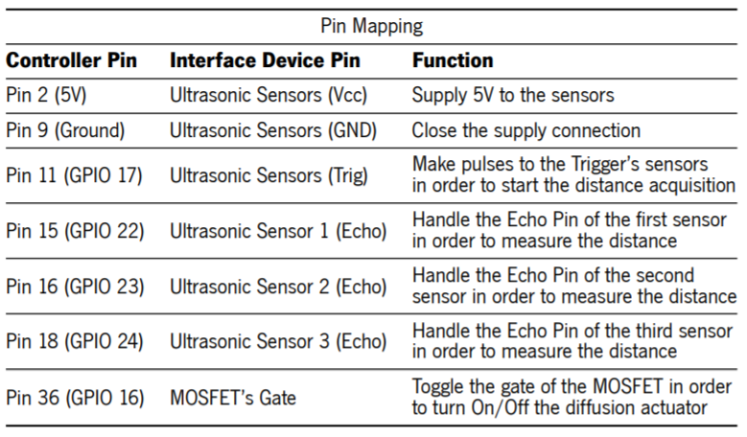
Design Hardware Interfaces Definition

Slide 50
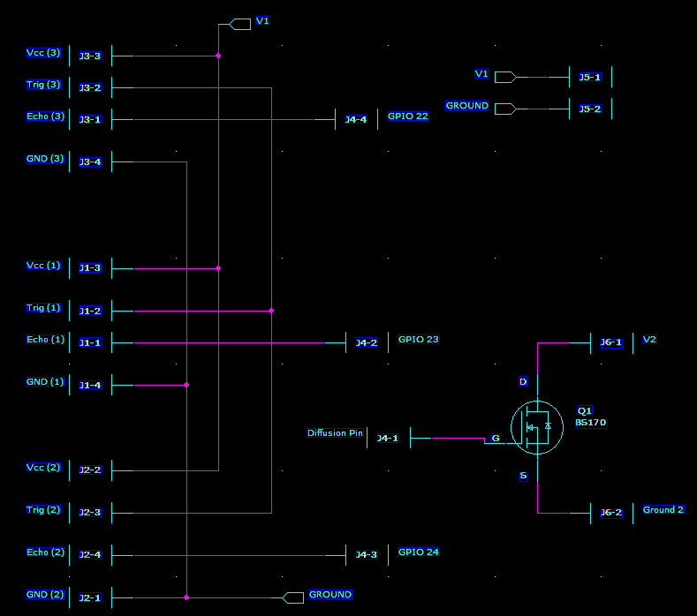
Design PCB Design
Schematic

Slide 51
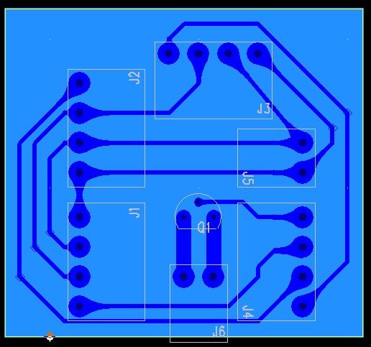
Design PCB Design
Layout

Slide 52
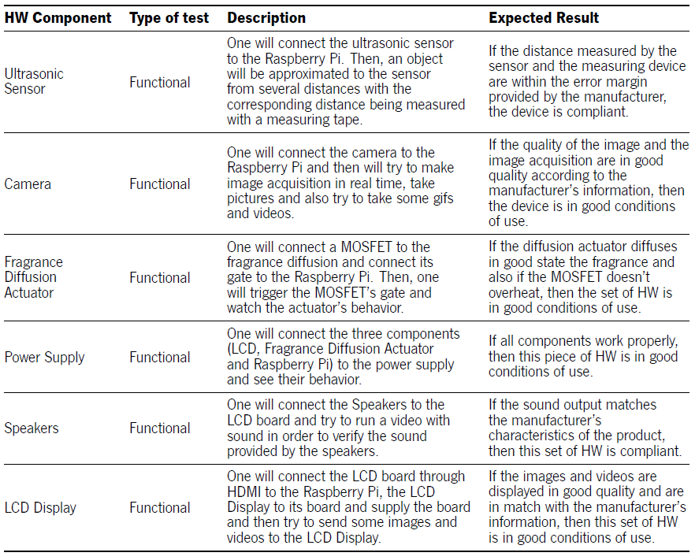
Design Hardware Test Cases

Slide 53
Design Hardware Tools
PADS
Logic
Layout

Slide 54
3.2. Software

Slide 55
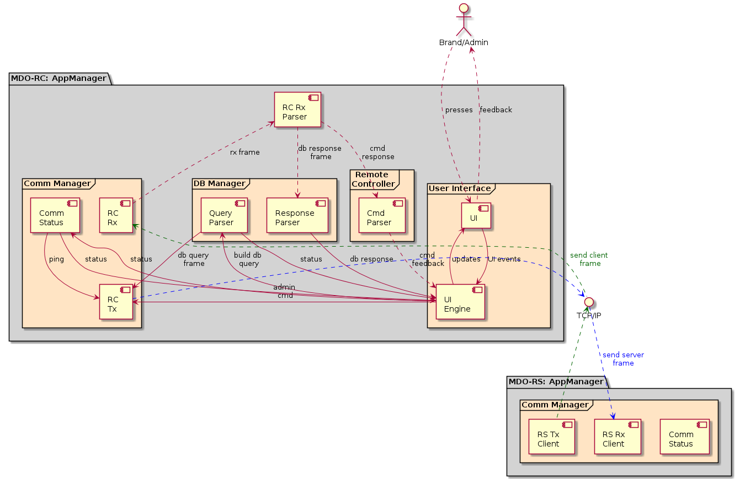
Design Component Diagram
Remote Client

Slide 56
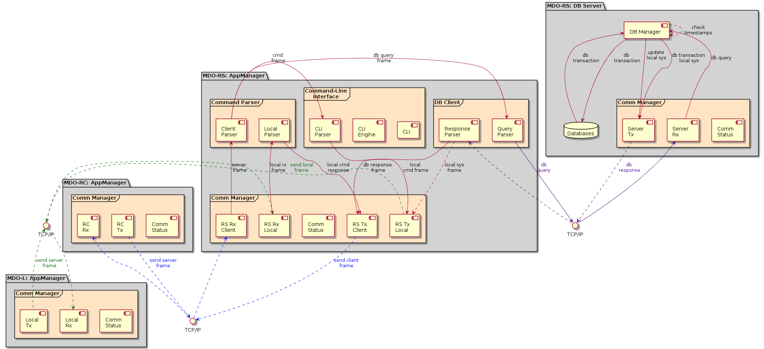
Design Component Diagram
Remote Server

Slide 57
Design Component Diagram
Remote Server (1/2)

Slide 58
Design Component Diagram
Remote Server (2/2)

Slide 59
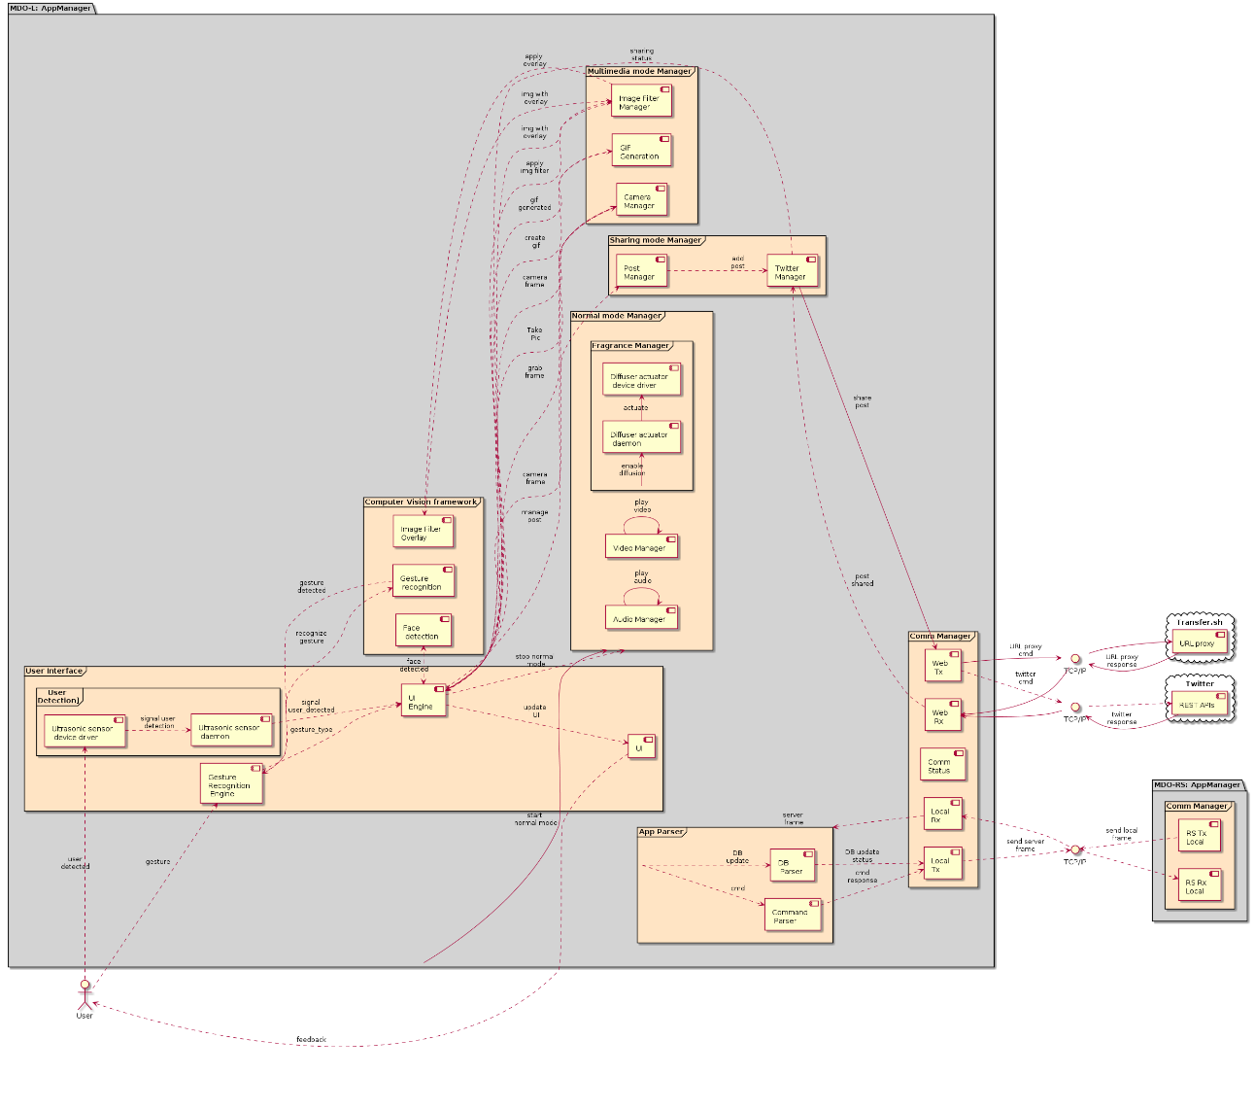
Design Component Diagram
Local System

Slide 60

Design Component Diagram
Local System (1/3)

Slide 61
Design Component Diagram
Local System (2/3)

Slide 62
Design Component Diagram
Local System (3/3)

Slide 63
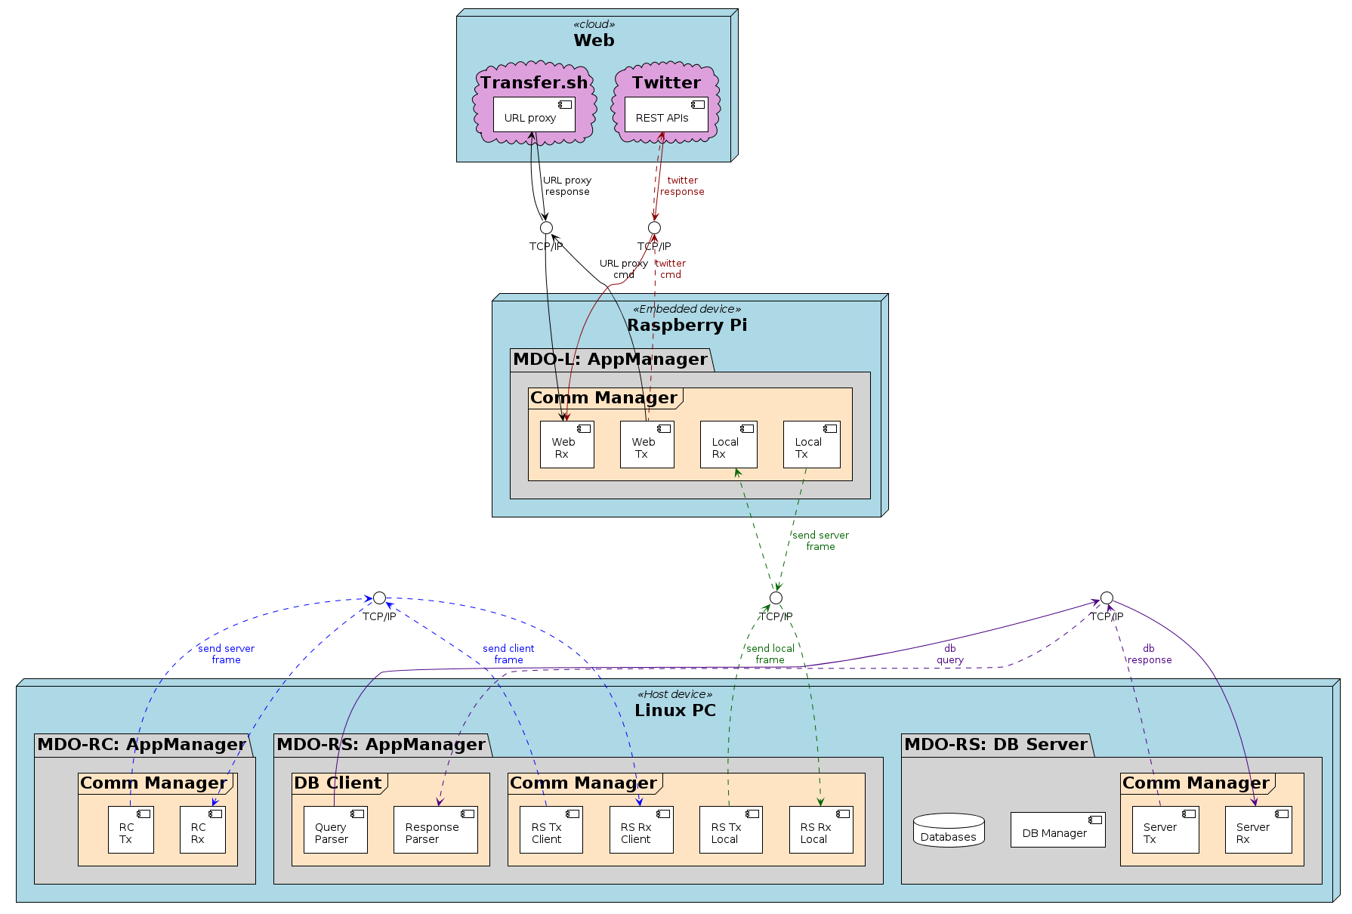
Design Deployment Diagram

Slide 64
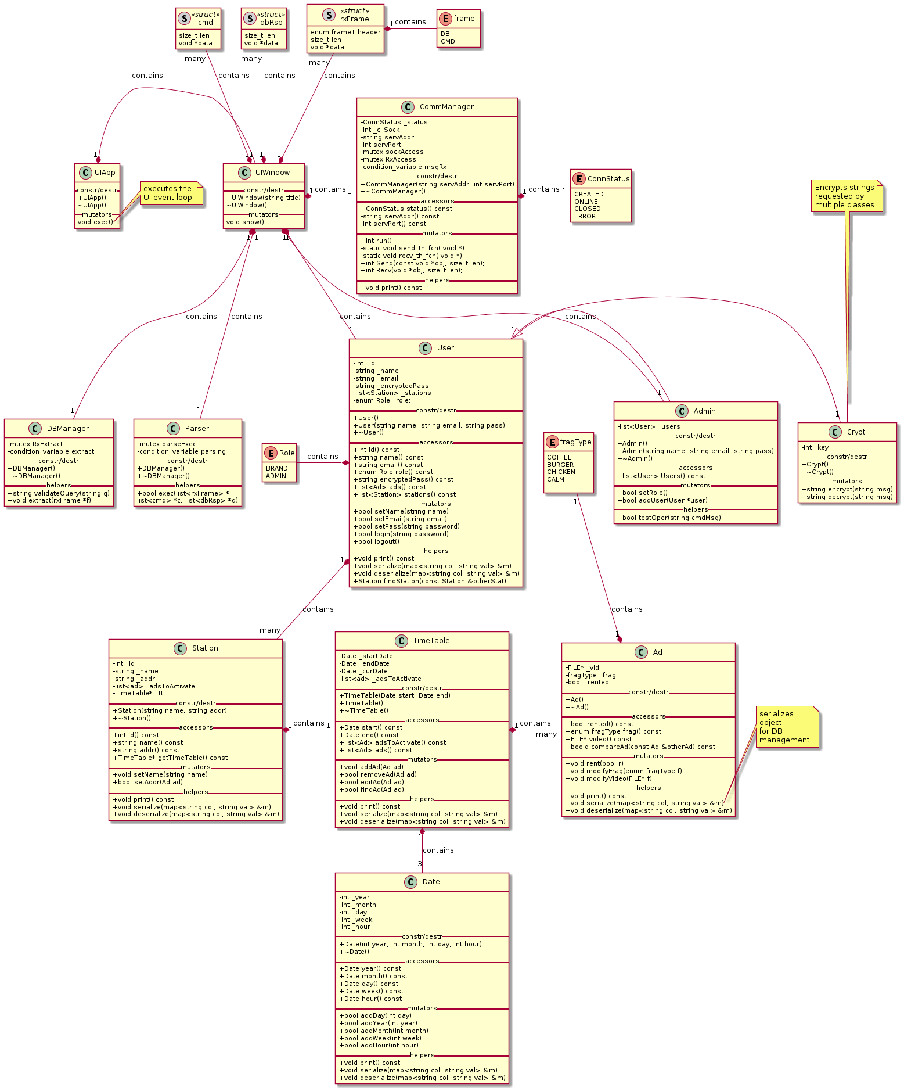
Design Class Diagram
Remote Client

Slide 65
Design Class Diagram
Remote Client (1/4)

Slide 66
Design Class Diagram
Remote Client (2/4)

Slide 67
Design Class Diagram
Remote Client (3/4)

Slide 68
Design Class Diagram
Remote Client (4/4)

Slide 69
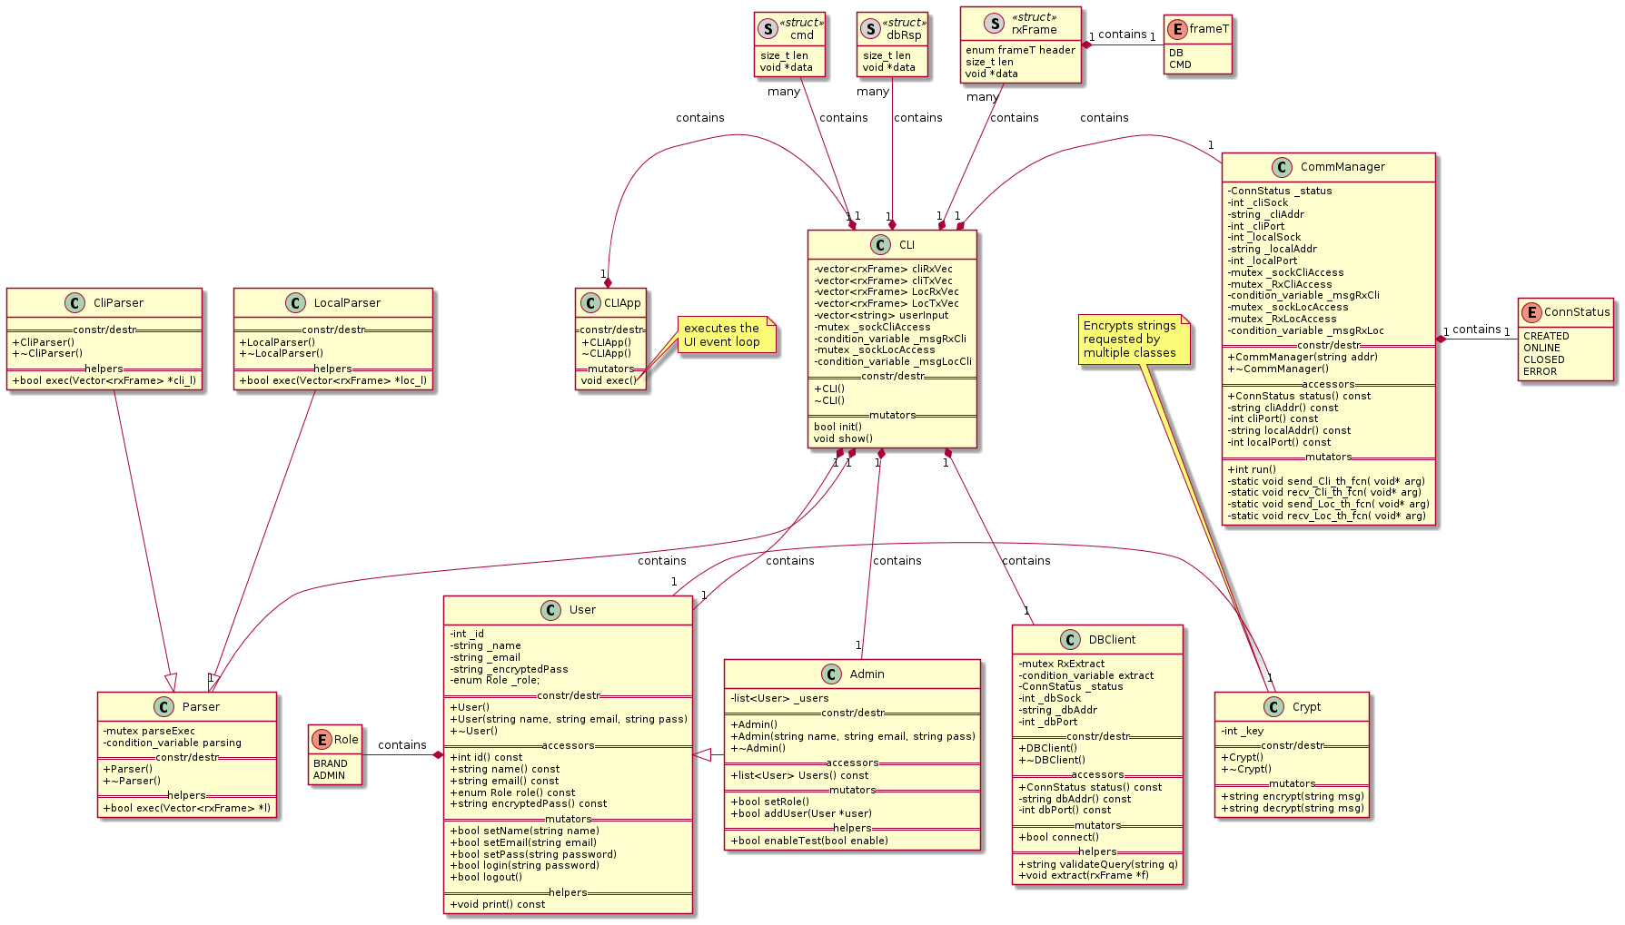
Design Class Diagram
Remote Server

Slide 70
Design Class Diagram
Remote Server (1/4)

Slide 71
Design Class Diagram
Remote Server (2/4)

Slide 72
Design Class Diagram
Remote Server (3/4)

Slide 73
Design Class Diagram
Remote Server (4/4)

Slide 74
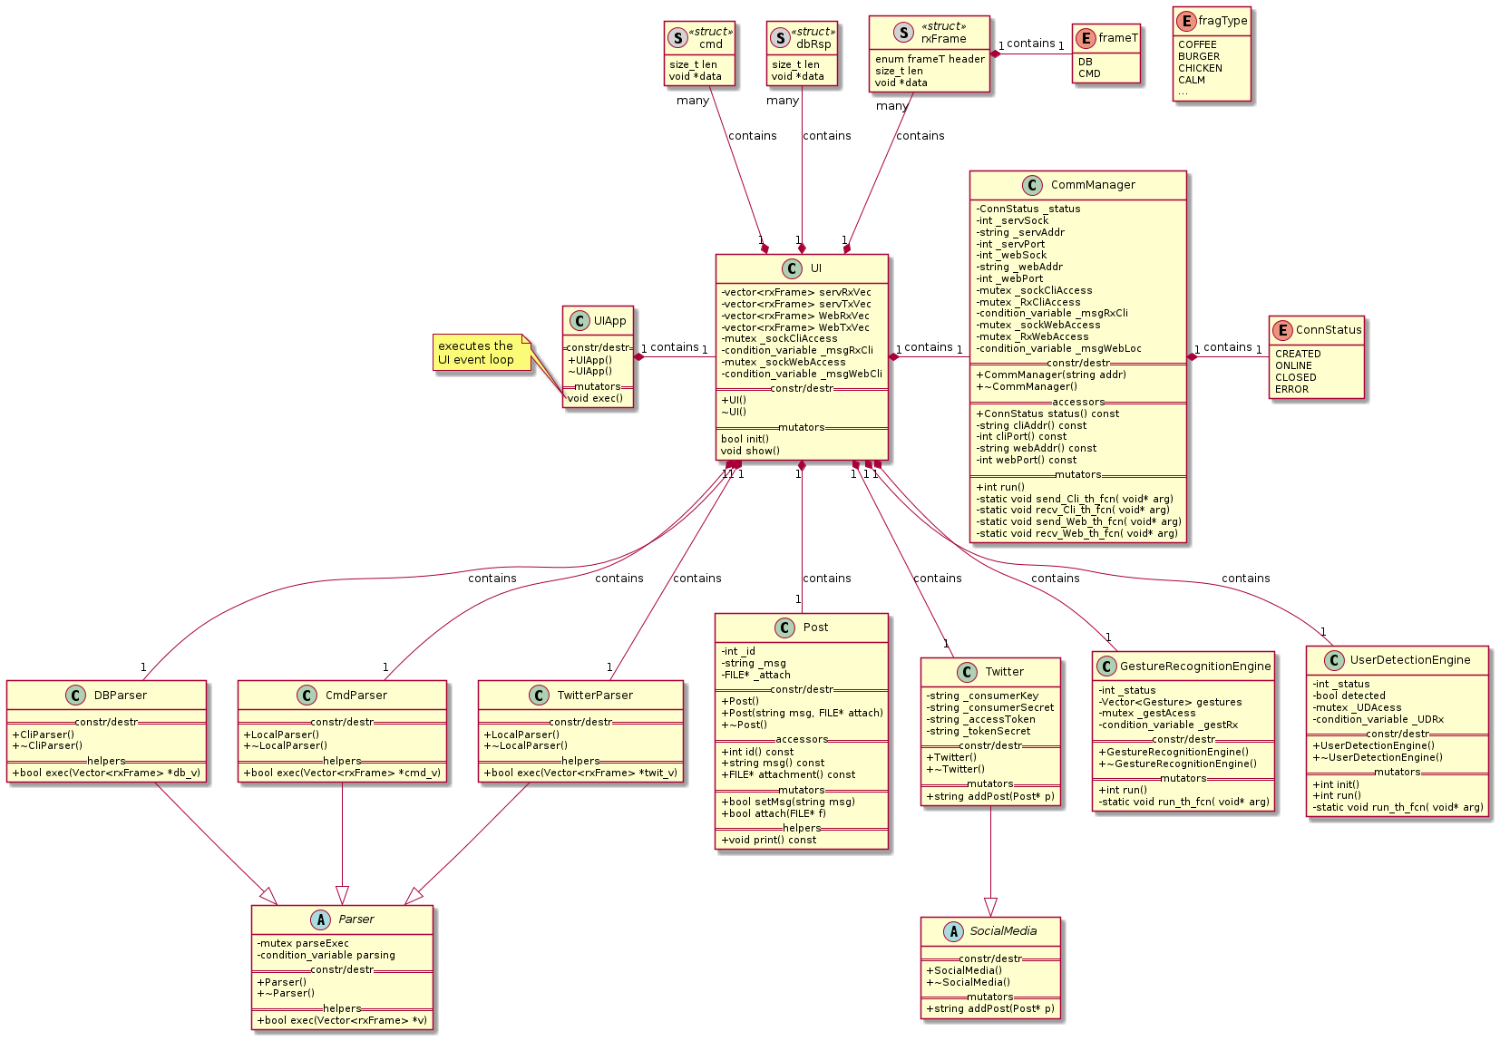
Design Class Diagram
Local System (1)

Slide 75
Design Class Diagram
Local System (1): 1/3

Slide 76
Design Class Diagram
Local System (1): 2/3

Slide 77
Design Class Diagram
Local System (1): 3/3

Slide 78
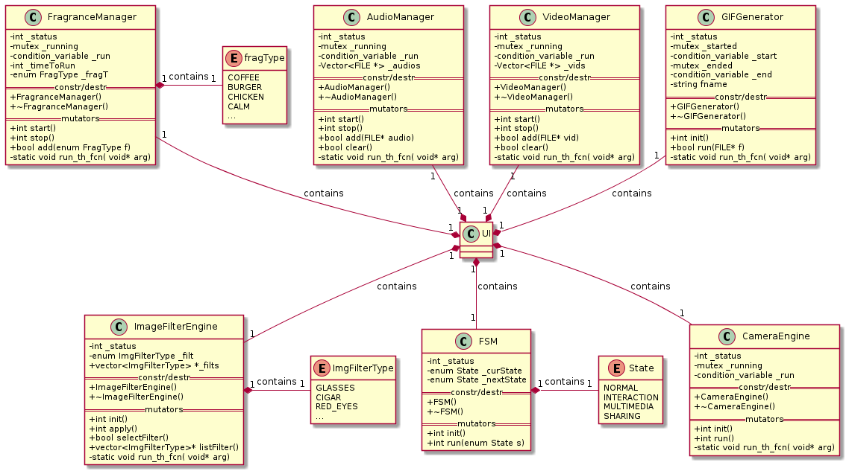
Design Class Diagram
Local System (2)

Slide 79
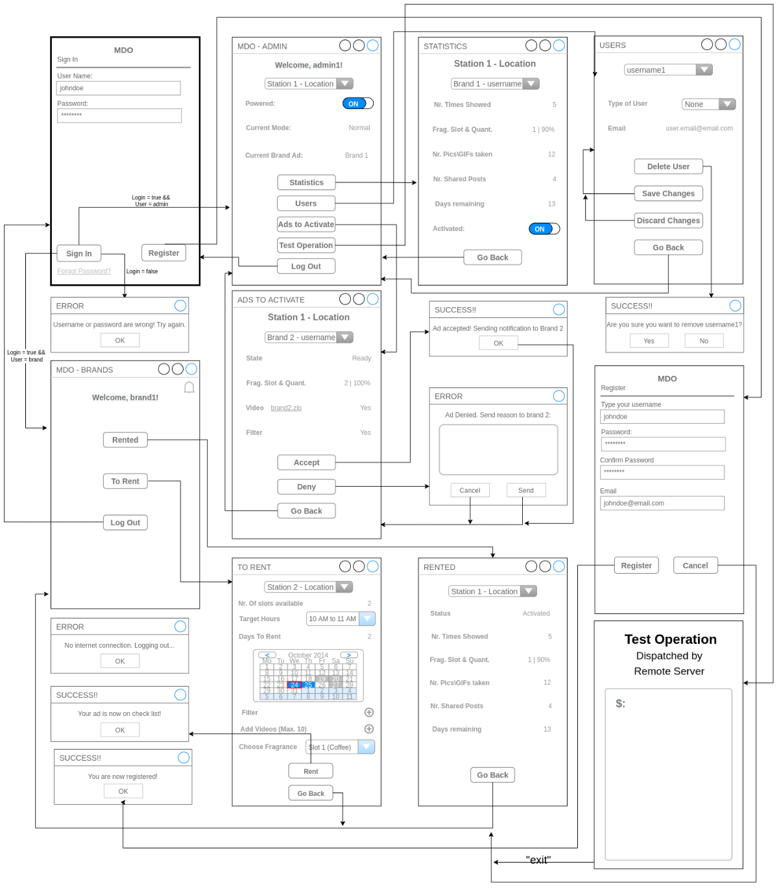
Design GUI Layouts
Remote Client

Slide 80

Design GUI Layouts
Remote Client (1/2)

Slide 81
Design GUI Layouts
Remote Client (2/2)

Slide 82
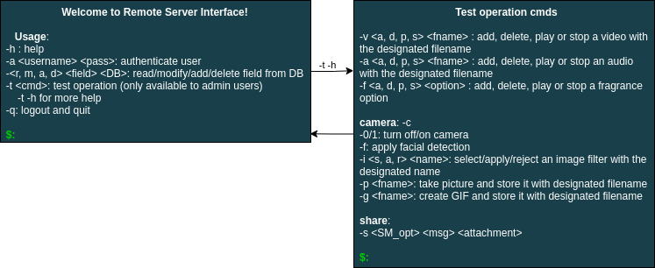
Design GUI Layouts
Remote Server

Slide 83
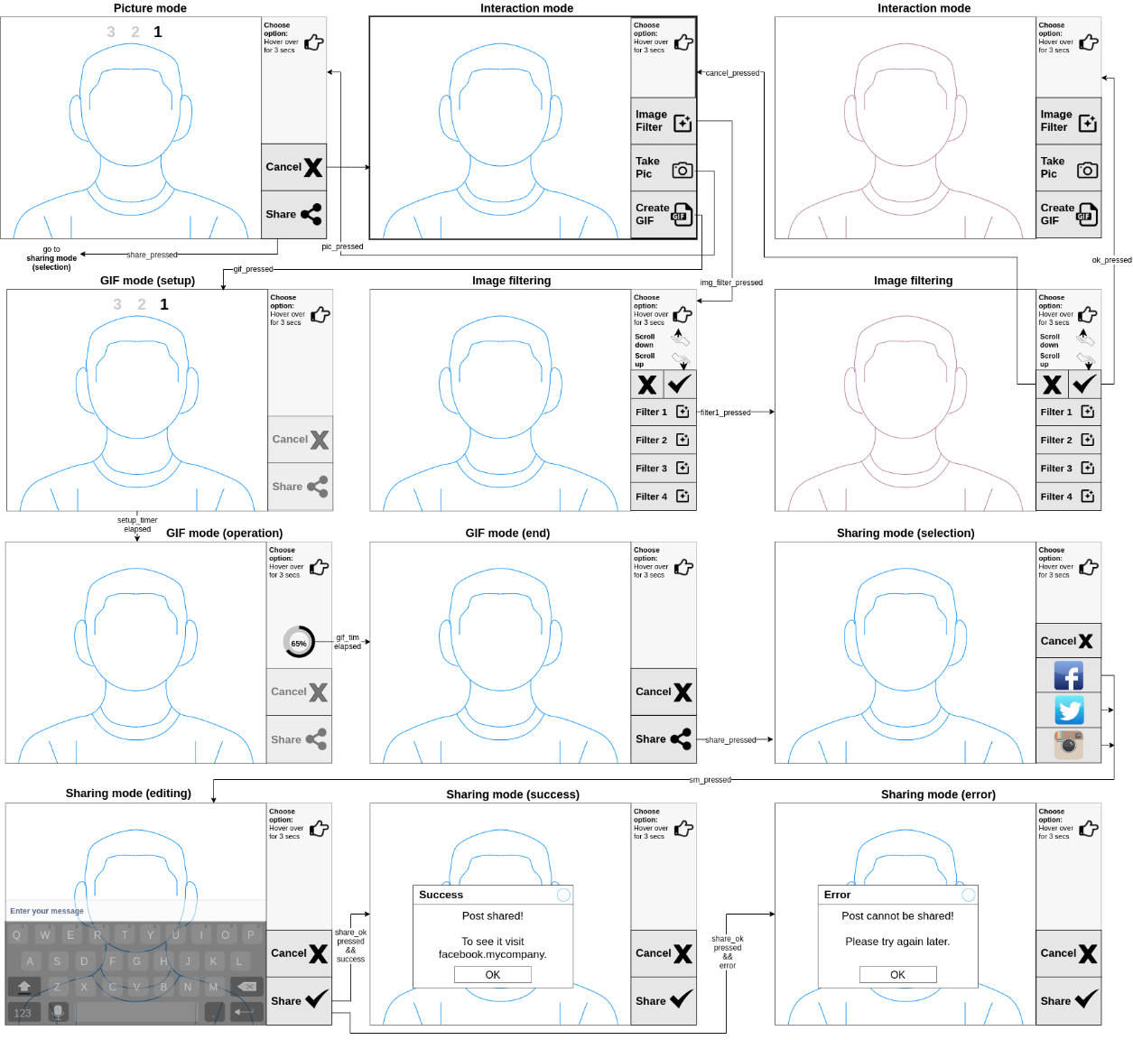
Design GUI Layouts
Local System

Slide 84
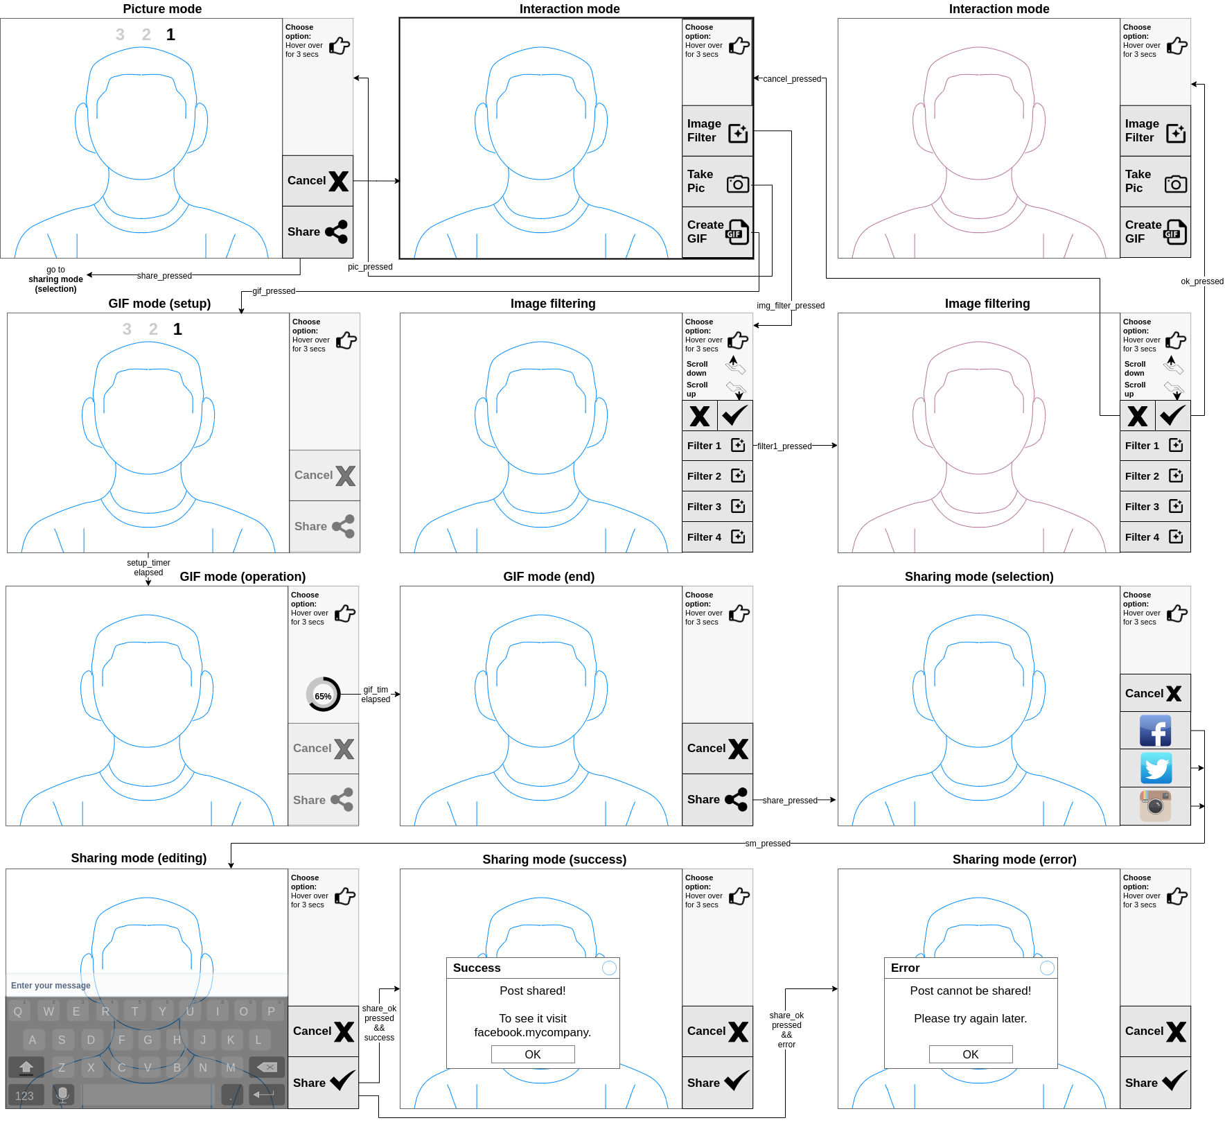
Design GUI Layouts
Local System (1/2)

Slide 85
Design GUI Layouts
Local System (2/2)

Slide 86
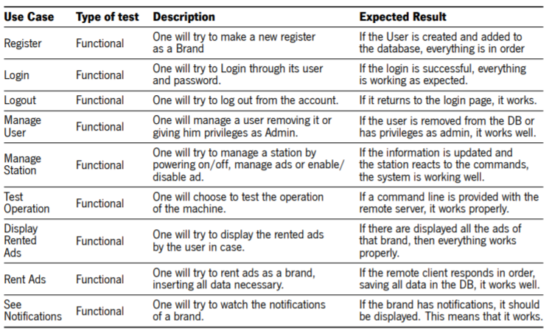
Design Software Test Cases
Remote Client

Slide 87
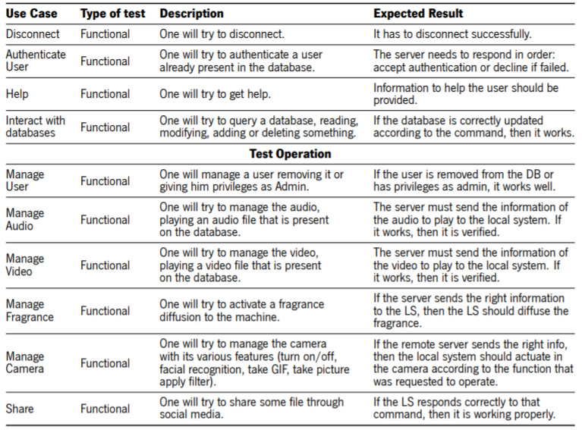
Design Software Test Cases
Remote Server

Slide 88
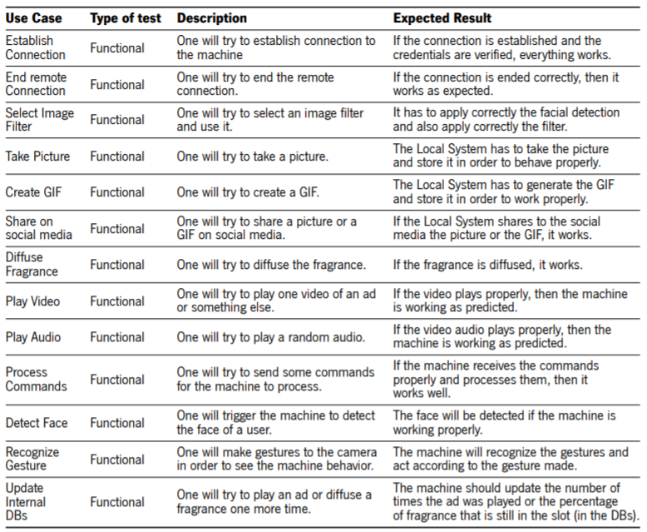
Design Software Test Cases
Local System

Slide 89
Design Software Test Cases
Local System

Slide 90
Design Class Topics mapping (Local System)
Device drivers & Daemons:
Pthreads: multithreading
TCP/IP: client-server architecture between LS and RS
Task synchronization:
Mutexes
Condition variables
Semaphores

Slide 91
Design Third-party libraries & APIs
Local System
OpenCV: computer vision
Magick++: GIF generation
MySQL: DB management
Twitter REST APIs
Curlpp + Transfer.sh: file transfer
Qt: UI framework

Slide 92
Design Software Tools
Plantuml: draw UML diagrams
Make: and makefiles
Doxygen: source-code documentation
Qt: UI Framework
Buildroot
Linux

Slide 93

References

Slide 94

References

Slide 95

References

Slide 96

References

Slide 97

References

Slide 98

References

Slide 99

References

Slide 100

References

